Slide 1
Analysis and Prediction of sales for UT Mart
Akhil Mallepally
12/02/2021

Slide 2
Dataset & Attributes
I have used the UT Mart dataset that can be found from the below resource
https://github.com/utkarsh-yadav1231/Tableau-Projects/blob/master/UT%20Mart%20Sales%20Analytics/UT%20Mart%20csv%20file.csv
Quantitative data: number of records : 9994 number of columns : 19
Attributes from the dataset are described in the following slides.

Slide 3
Attributes
Order ID: ID of the order. This is unique to each order. Order Date: The date the product ordered by the customer. Ship Date: The date the product is shipped to the customer Ship Mode: The shipping mode is of three categories namely, Standard, Second and First. Customer ID: ID of the customer that is ordering the product. This ID is unique to each customer. Customer Name: Name of the customer. This is associated with the customer ID. Sales Agent ID: A sales agent can be assigned to multiple customers. But each customer has only one Sales agent assigned. This is represented with Agent ID. Each ID represents one unique Sales Agent. Country/Region: Country the order was placed. City: City attribute represents the city the order was placed. State: This attribute refers to the state the city is situated in.

Slide 4
Contd..
Postal code: This is associated with the city. Each city have unique postal code. Region: Region refers to the part the state/ city located in the country. There are four regions, East, West, South, North. Product ID: This is associated with the product. Product ID is unique to each product Category: This field have the category of the product belongs to. Like Office supplies, Furnitures Sub-Category: This field consists of subcategory of a category. Like Storage, binder which belongs to Office supplies Product Name: Name of the product is stored in this column. Sales: Number of sales for each order Quantity: Total quantity of products sold for a particular order

Slide 5
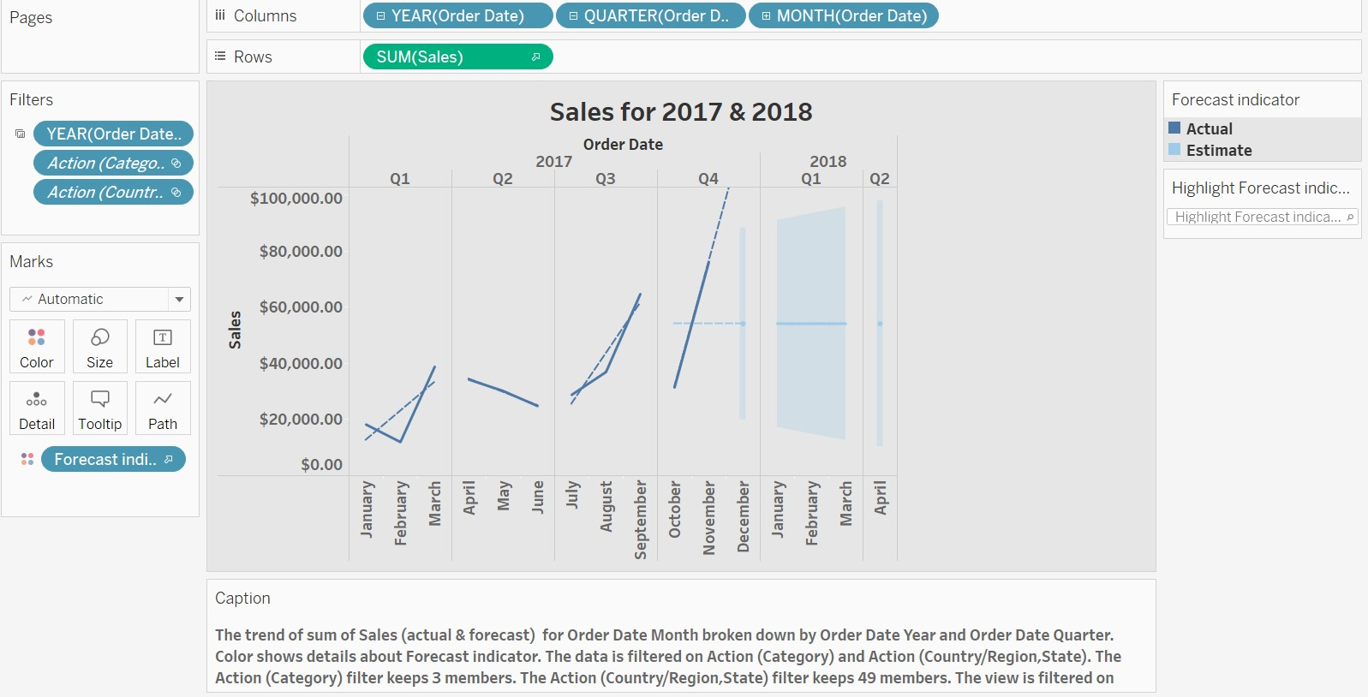
Goal 1:
Analyze the trends per each quarter in 2017 and forecast the sales for 2018.

Slide 6
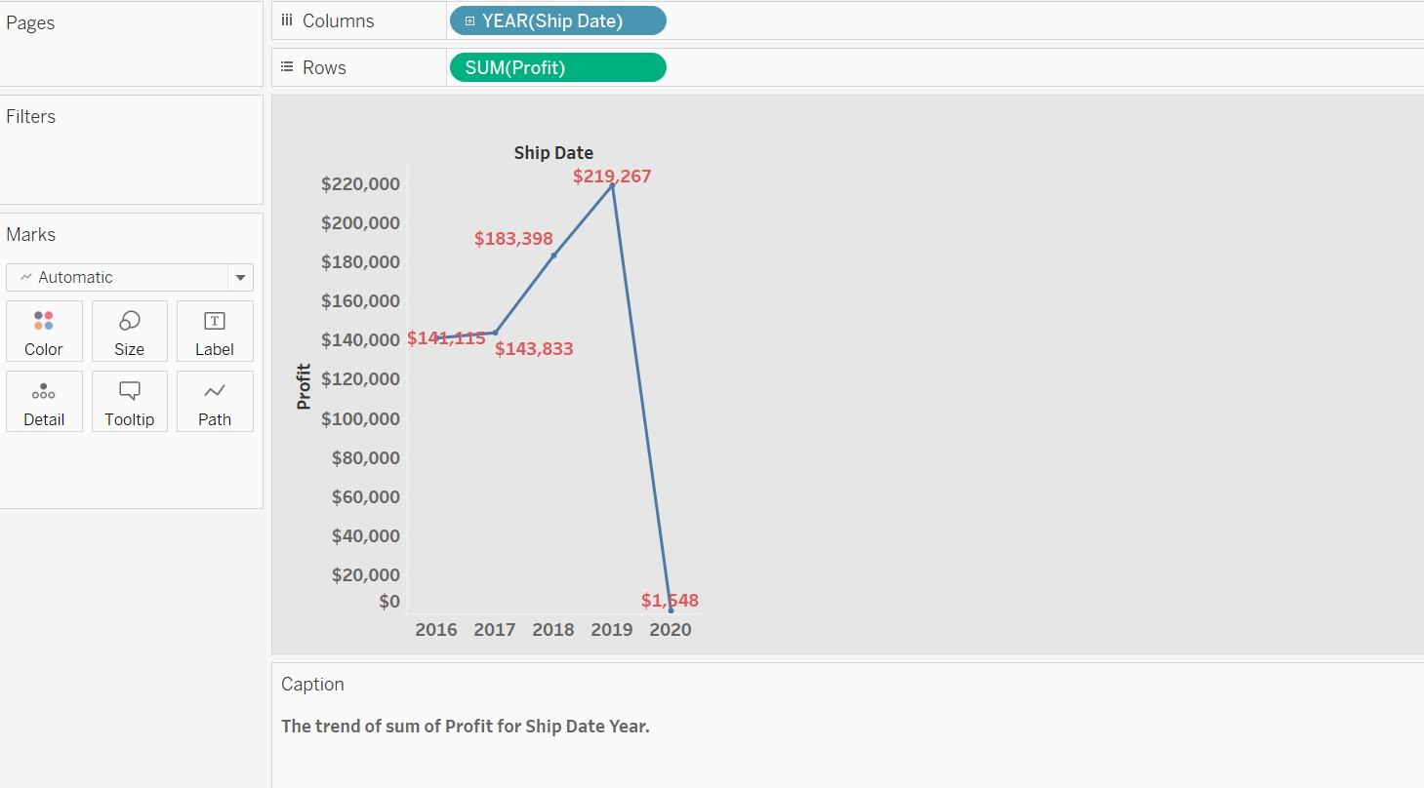
Goal 2:
Observe the trend of profits per each year

Slide 7
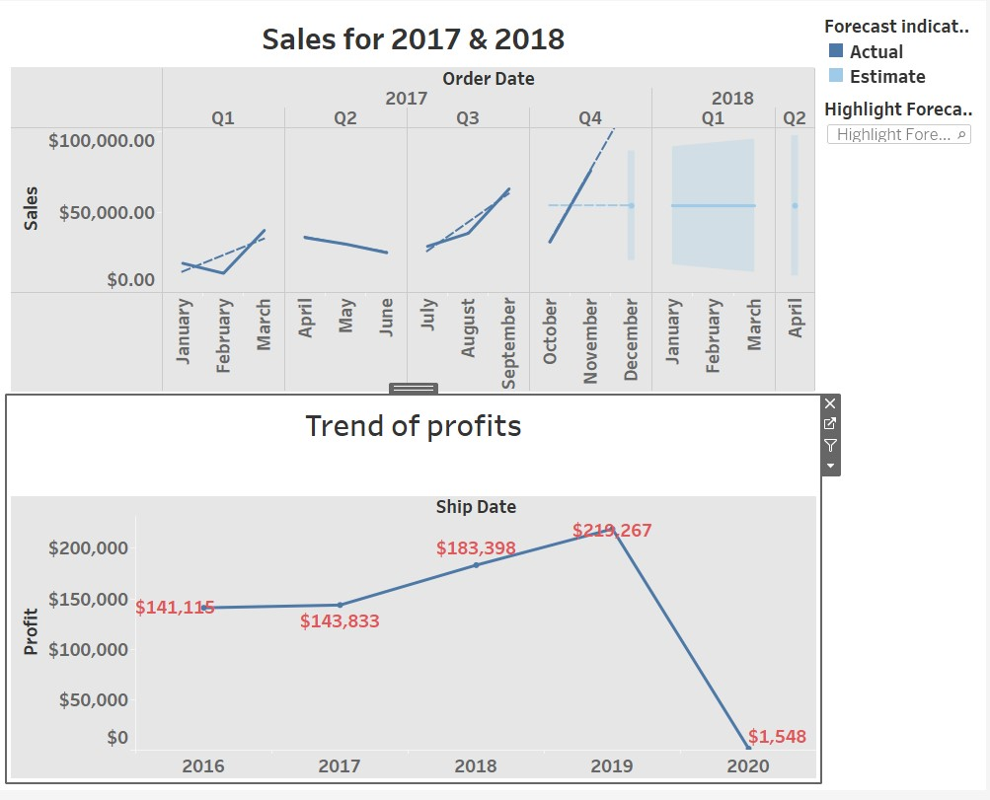
We can observe the relation
We can observe the trend for sales in 2017 and we can see the profits associated in the line chart which shows that the prediction is similar.

Slide 8
End Note
End note of any visualization is the beginning note of its application for the business requirement.
Investigate and apply the results to improve the business performance, strategically!

